Slide 1
Volume Flyswatter

Slide 2
What is three plus four?

Slide 3
Twelve
Four
Six
Seven
Zero
One
Two
Eleven
Eight
Five

Slide 4
What is the name of this shape?

Slide 5
Cube
Rectangular Prism
Triangular Prism
Cylinder
Circle
Triangle
Rectangle
square
Rhombus
Trapezoid

Slide 6
What is the volume of a rectangular prism with base area 5 cm² and height 10 cm?

Slide 7
50 m³
50 cm³
250 cm³
250 cm²
50 cm²
250 m²
250 m³
50 m²
25 cm³
500 cm³

Slide 8
What is the volume of a rectangular prism with length 3 m, width 2 m and height 4 m?

Slide 9
24 m³
24 cm³
240 cm³
240 cm²
24 cm²
24 m²
240 m³
48 m²
12 cm³
12 m³

Slide 10
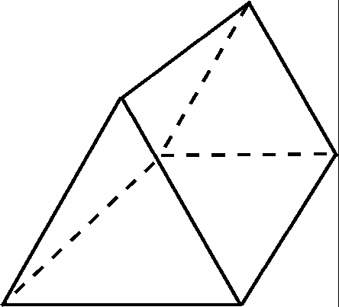
What is this shape called?

Slide 11
Cube
Rectangular Prism
Triangular Prism
Cylinder
Circle
Triangle
Rectangle
square
Rhombus
Trapezoid

Slide 12
What is the volume of a triangular prism with base area 15 cm² and height 3 cm?

Slide 13
45 m³
675 cm³
450 cm³
450 cm²
45 cm²
675 m²
450 m³
45 m²
45 cm³
675 m³

Slide 14
What is the volume of a triangular prism with triangle height 5 mm, triangle base 4 mm and prism height 6 mm?

Slide 15
60 mm³
120 cm³
120 cm³
120 cm²
60 cm²
120 mm³
120 m³
60 m²
60 cm³
60 mm²

Slide 16
What is this shape called?

Slide 17
Cube
Rectangular Prism
Triangular Prism
Cylinder
Circle
Triangle
Rectangle
square
Rhombus
Trapezoid

Slide 18
What is the volume of a cylinder with radius 2 cm and height 10 cm?

Slide 19
62.8 mm³
62.8 cm²
31.4 cm³
31.4 cm²
31.4 cm²
31.4 mm³
62.8 m³
62.8 m²
62.8 cm³
31.4 mm²

Slide 20
What is the volume of a cylinder with diameter 5 cm and height 7 cm (rounded to 1 decimal place)?

Slide 21
549.5 mm³
137.4 cm²
549.5 cm³
549.5 cm²
109.9 cm²
137.4 mm³
137.4 m³
137.4 m²
549.5 m³
137.4 cm³

Slide 22
What is the height of a prism with volume 60 m³ and base area 15 m²?

Slide 23
4 mm³
4 cm
900 cm³
4 cm²
4 m³
900 mm³
4 m
900 m²
900 m³
4 cm³

Slide 24
What is the volume of a rectangular prism with length 20 cm, width 40 cm and height 0.6 m?

Slide 25
480 m³
48 000 cm³
480 cm³
48 000 cm²
480 cm²
48 000 mm³
48 000 m
48 000 m²
48 000 m³
480 cm

