Slide 1
Foundations of Math11: 7.1-7.4 Review

Slide 2
Factoring
Factor the Following trinomials

Slide 3
Factoring
Factor the Following trinomials

Slide 4
Working with an equation
Determine the following information for the function
y = x² – 7x + 10
y-intercept
x-intercept(s)
Axis of Symmetry
Vertex
Domain
Range

Slide 5
Working with an equation
Determine the following information for the function
y = x² – 7x + 10
y-intercept | (0,10)
x-intercept(s) | (5, 0), (2, 0)
Axis of Symmetry | x=3.5
Vertex | (3.5, -2.25)
Domain
Range

Slide 6
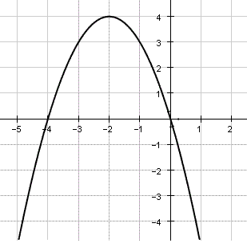
Interpreting a graph
For this graph:
What is the axis of symmetry?
Where is the vertex?
What are the zeroes of the function?
What is the formula for the function?

Slide 7
Interpreting a graph
For this graph:
What is the axis of symmetry?
x=-2
Where is the vertex?
(-2, 4)
What are the zeroes of the function?
x = -4, x = 0
What is the formula for the function?
f(x)=(x+4)x

Slide 8
Word Problems
The height of a football above the ground can be modelled by y = -4.9x² + 15x, where x is the time in seconds.
What is the maximum height of the ball above the ground?
How long is the ball in the air?

Slide 9
Word Problems
The height of a football above the ground can be modelled by y = -4.9x² + 15x, where x is the time in seconds.
What is the maximum height of the ball above the ground?
The maximum height is 11.5 m.
How long is the ball in the air?
The ball is in the air for 3.1 seconds.

Slide 10
Word Problems
The height of a football above the ground can be modelled by y = -4.9x² + 15x, where x is the time in seconds.
What is the maximum height of the ball above the ground?
The maximum height is 11.5 m.
How long is the ball in the air?
The ball is in the air for 3.1 seconds.

